Slide 1
EE 596 Final Project: Windows SWARM
By: Adam Iseman and David Molyneaux

Slide 2
Windows SWARM Evolved from Columbia SWARM
Intel-Cornell Cup Entrant
Four Grunts controlled by Intel Board based General
Didn’t work very well

Slide 3
Simple Grunt Details:

Slide 4
Pan/Tilt Grunt Details:

Slide 5
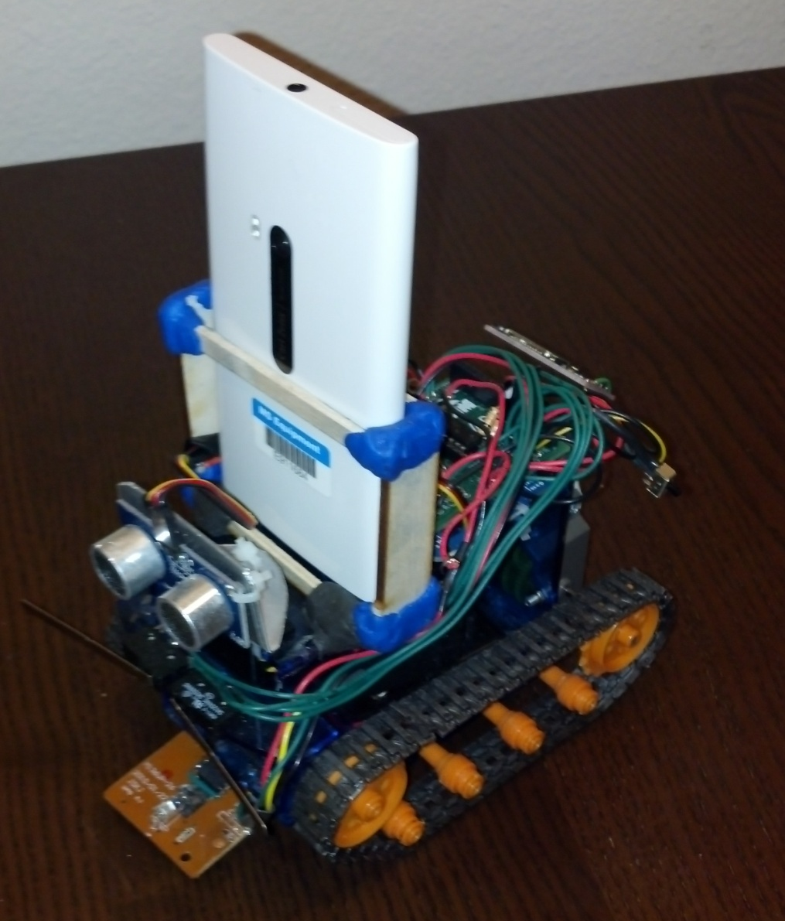
Phone Grunt Details:

Slide 6
Button Control:
Bluetooth link established by radio buttons
Commands issued by pressing buttons

Slide 7
Sensor Control:
Hold phone horizontally
Commands issued by tilting phone forward to drive forward, back to reverse, etc.
Sensor control is stopped by pressing STOP button

Slide 8
Pan/Tilt Control:
Hold phone horizontally
Drive Commands issued by tilting phone forward to drive forward, back to reverse, etc.
Pan/Tilt servos controlled by sliders
WiFi camera feed displayed on laptop

Slide 9
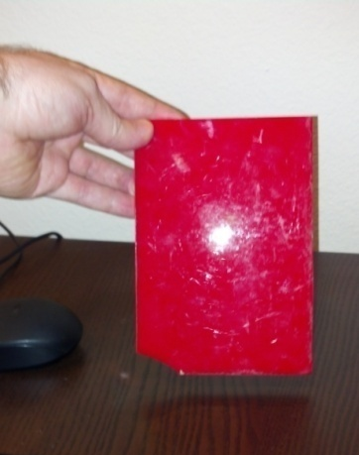
Camera Control:
Mount phone on camera Grunt
Press start
Phone searches camera feed for red rectangle
If rectangle area shrinks phone issues forward command, etc.
Exited by pressing button again

Slide 10
Map Building:
Optical mouse data pulled in from each Grunt
Positions tracked from known initial positions
Generates map of environment

Slide 11
The End

